Slide 1

COMMUNITY SERVICE PROJECT Final Review 216CSE3203

Slide 2
Introduction
Chronic illness such as heart attack and Diabetics is a disease that lasts a long time or takes a long time to heal, and many chronic diseases cannot be cured but can only be managed with daily treatments.
Heart disease, particularly heart attacks, remains one of the leading causes of death worldwide.
When anyone is currently afflicted with an illness, they must see a doctor, which is both time consuming and expensive.
Disease Predictor is a web-based program that predicts a user's disease based on the symptoms they have.
Early detection and risk assessment are crucial in preventing heart attacks and improving overall cardiovascular health.

Slide 3

Objective
To identify various diseases by observing the symptoms of patients and applying various Machine Learning Models techniques.
The prediction of heart attack is a growing field of medical research.
With the help of advanced algorithms and data analysis, researchers are able to accurately predict the likelihood of developing these medical conditions.

Slide 4
Benefits to Common People
Heart attack prediction raises awareness about cardiovascular health. This leads to more informed choices regarding diet, exercise, and overall lifestyle, benefiting the entire community.
A healthier community is a more prosperous one. When heart attack risk is reduced through prediction and prevention, communities experience fewer health crises and can allocate resources to other pressing needs.
Early detection and prevention not only save lives but also improve the quality of life for those at risk. Patients can enjoy healthier, more active lives with fewer health complications.
Early prediction allows individuals at higher risk to receive timely medical attention and make lifestyle changes. This can prevent heart attacks or reduce their severity.

Slide 5
Heart Attack Disease Prediction

Slide 6
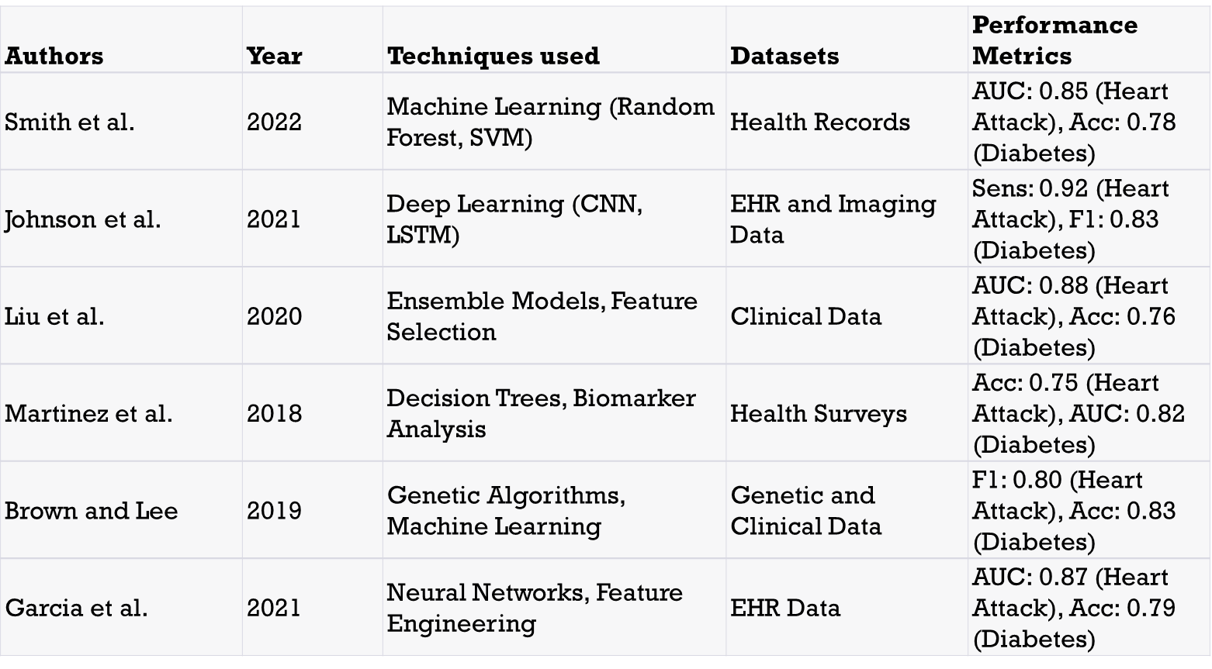
Literature Survey

Slide 7
SOFTWARE/HARDWARE
Developing a system for Heart attack disease prediction involves a variety of software tools and frameworks for data processing, model development, and deployment. Here are some of the commonly used software components:
Python: Python is a versatile programming language commonly used in machine learning and deep learning projects. It serves as the primary language for implementing the project.
2. Deep Learning Frameworks
TensorFlow : TensorFlow is an open-source deep learning framework developed by Google. It provides a robust ecosystem for building and training neural networks, including RNNs.
PyTorch : PyTorch is another popular deep learning framework known for its flexibility and dynamic computation graph, making it well-suited for RNNs.

Slide 8
SOFTWARE/HARDWARE
Data Preprocessing:
OpenCV: OpenCV (Open Source Computer Vision Library) is used for image and video preprocessing, including tasks like resizing, normalization, and feature extraction.
Pandas: Pandas is a data manipulation library in Python that can be useful for organizing and cleaning data.
Deployment:
Flask or Django: For creating web-based applications, Flask or Django (Python web frameworks) can be used to serve the model as a web service.
Mobile App Development Frameworks: If deploying on mobile devices, frameworks like Flutter (for cross-platform apps) or Android Studio (for Android) can be used.

Slide 9
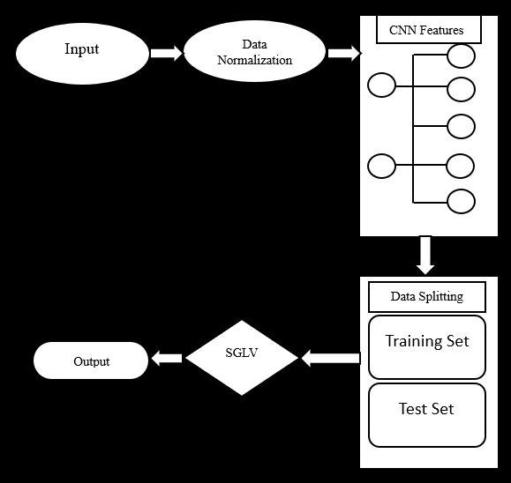
System Design/Algorithm

Slide 10
PROGRAMMING CODE

Slide 11
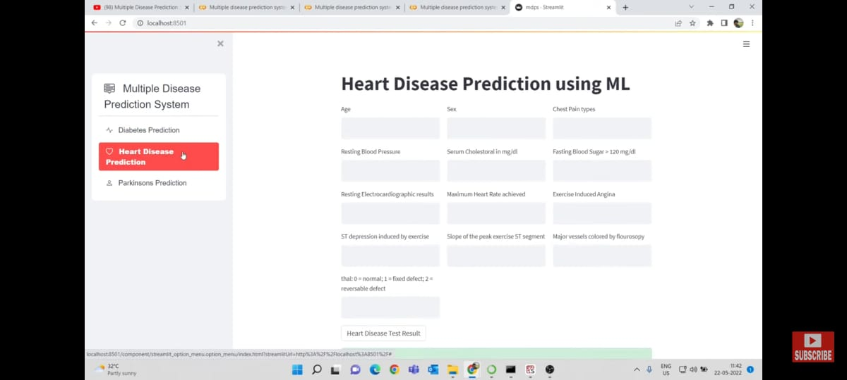
Result

Slide 12
Conclusion
Early detection of heart conditions could help avoid heart attack-related deaths. A good classification system may enable the doctor to identify cardiovascular disease before it manifests itself. This study employs convolutional neural networks (CNN) with a cutting-edge dataset found in the UCI library to identify potential cardiac illness. Some heart test parameters as well as typical human behaviors are included in this dataset. The outcomes demonstrate that the suggested model outperforms the current methods mentioned in this research. The proposed model's total accuracy is 97%.The future, we hope to improve this research effort by making predictions about the likelihood of developing heart attack disease.

Slide 13
References
Effective Heart Disease Prediction Using Hybrid Machine Learning Techniques, Digital Object Identifier 10.1109/ACCESS.2019.2923707, IEEE Access, VOLUME 7, 2019
S.P. Bingulac, On the Compatibility of Adaptive Controllers, Proc. Fourth Ann. Allerton Conf. Circuits and Systems Theory, pp. 8-16, 1994. (Conference proceedings)
Senthil kumar Mohan, Chandra segar Thirumalai, Gautam Srivastava
Sonam Nikhar, A.M. Karandikar Prediction of Heart Disease Using Machine Learning Algorithms International Journal of Advanced Engineering, Management and Science (IJAEMS) Infogain Publication,[Vol-2, Issue-6, June- 2016].I.S. Jacobs and C.P. Bean, Fine particles, thin films and exchange anisotropy, in Magnetism, vol. III, G.T. Rado and H. Suhl, Eds. New York: Academic, 1963, pp. 271-350.
Aditi Gavhane, Gouthami Kokkula, Isha Pandya, Prof. Kailas Devadkar (PhD), Prediction of Heart Disease Using Machine Learning, Proceedings of the 2nd International conference on Electronics, Communication and Aerospace Technology (ICECA 2018).IEEE Conference Record # 42487; IEEE Xplore ISBN:978-1- 5386-0965-1

Slide 14


